Slide 1
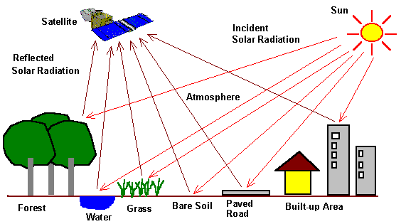
Electromagnetic Radiation In Remote Sensing
Presented By
Dr. Banashree Saikia
Assistant Professor
Department of Geography
JN College, Boko

Slide 2
Electro Magnetic Radiation is one of the important component Remote Sensing Technique.
Electro magnetic Energy and Properties of Electro magnetic wave
Nature of Electromagnetic energy
Visible light is only one of many forms of electromagnetic energy. Gamma rays,X rays, UV rays, visible rays, infra red rays, thermal rays, microwave, radio are other familiar forms.
All energy moves with the velocity of light (300000km/S) in a harmonic wave pattern.
A harmonic pattern consists of waves that occur at equal intervals in time.
The number of occurrence of such waves at a particular fixed point per unit of time is the frequency (v).
The distance between the successive centre of wave peaks of the wave is the wavelength [(λ)lambda].

Slide 3
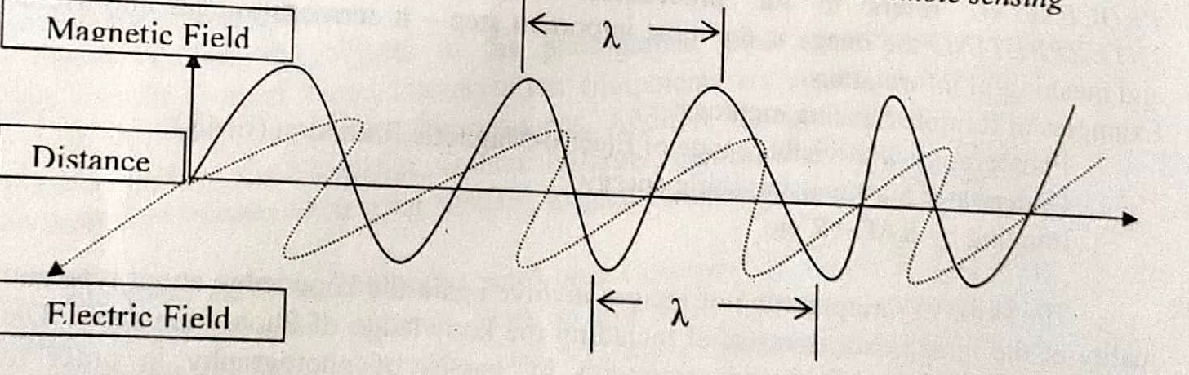
Fig:An electromagnetic wave
Electric field and magnetic field are mutually perpendicular.
These are also perpendicular to the direction of propogation.

Slide 4
Generally frequency is measured in terms of Hertz(HZ).
It denotes as one cycle per second.
The higher order units of frequency are Kilohertz(KHZ), Megahertz (MHZ) and Gigahertz (GHZ).
The terms of designate frequencies and their relationships are as follows:
Hertz(HZ) = One Cycle/Second
KHZ= 1000HZ
MHZ= 1,000000HZ
GHZ= 1,000,000,000 HZ

Slide 5
Properties of electromagnetic wave
Electromagnetic wave can be described in terms of Velocity (c) ,wavelength(λ), frequency (v).
c =λv, where c is essentially a constant(3*10⁸ m/sec ).
Frequency and wavelength are inversely related.
When the frequency is very high wavelength in that case will be very small.
Wavelength is generally measured in micrometer and designated by the symbol μm.

Slide 6
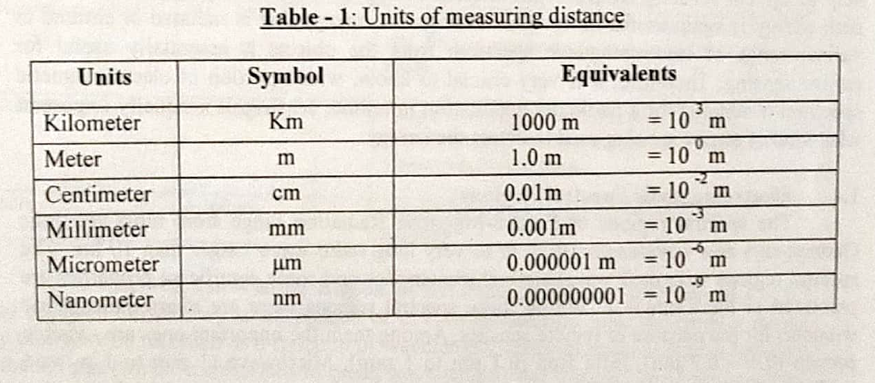
The units of measuring distances, large and small, are given in Table 1 for proper understanding of wave pattern of electromagnetic spectrum.

Slide 7
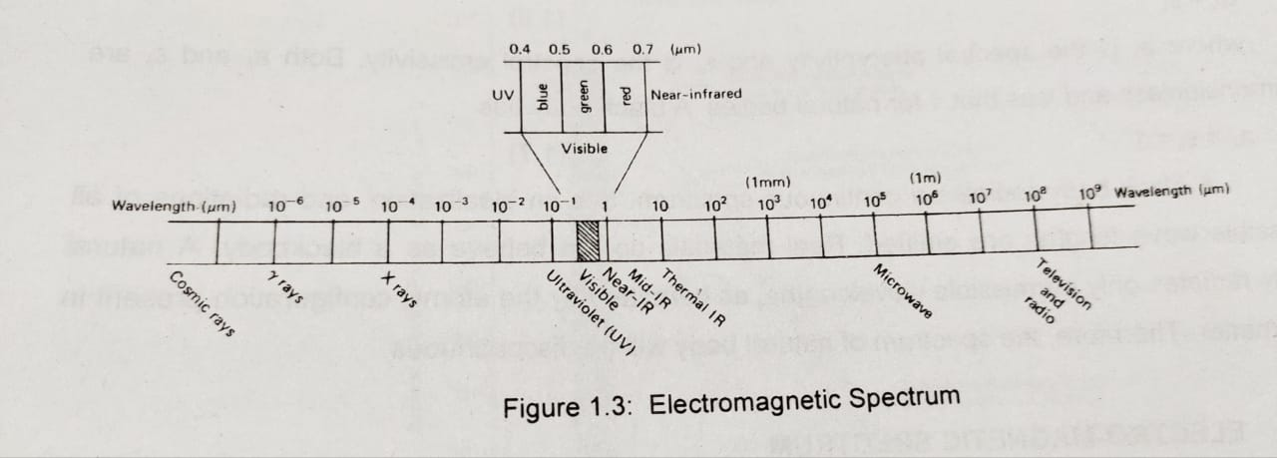
Electromagnetic spectrum is the ordering of EMR s according wavelength, or in other words , frequency or energy. The most prevelant unit used to measure wavelength along the spectrum is the micrometer (µm). A micrometer equals to 1*10⁻⁶.
Electromagnetic spectrum

Slide 8
Ems is a continuum of energy that ranges from meters to nano meters in wavelength, travels at the speed of light.
As the surface temperature of an object increases it has got the capability to transmit higher level of energy to be detected by remotely placed sensors.
The energy that is radiated or emitted in various range of electromagnetic spectrum from the objects is essentially useful for remote sensing.
Therefore it is very crucial to know, which portion of electromagnetic spectrum is suitable for a particular application in remote sensing.
It is equally important what kind of sensor is being used to detect the energy.

Slide 9
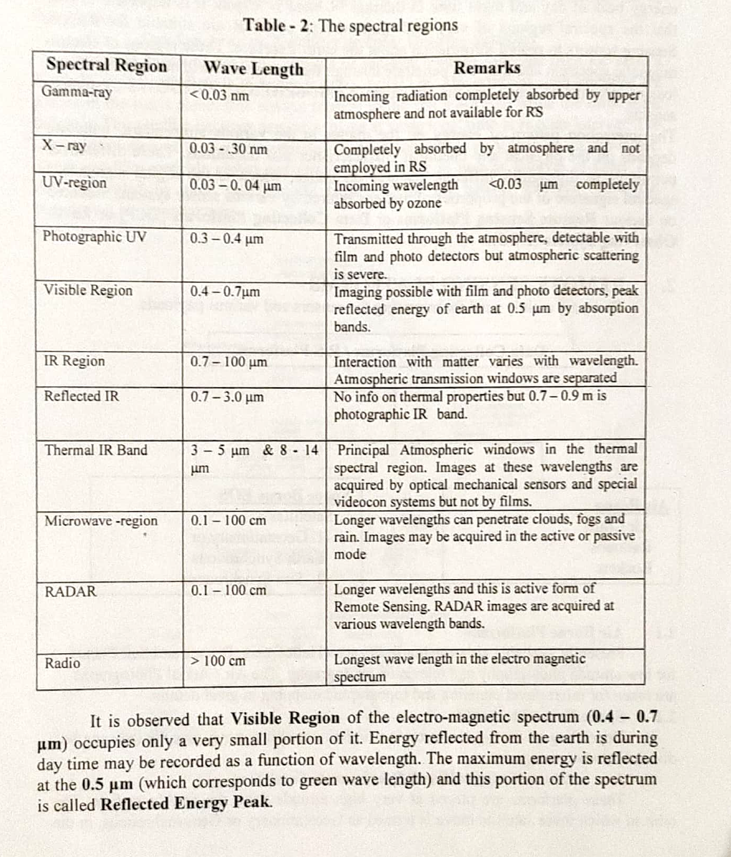
Electromagnetic Spectral Region

Slide 10
Energy Interaction In the Atmosphere
The atmosphere- radiation interaction process can be grouped
into three physical process
Sacttering , ii. Absobtion, iii. Emission
Atmospheric Scattering is the unpredictable diffusion of radiation by particle in the atmosphere. It occurs when particles or gas molecules present in the atmosphere.
Atmospheric absorption is that when atmospheric gases absorb radiation in certain wavelength while some other types of EMR can easily pass through the atmosphere.
The areas of the EM spectrum that are absorbed by the atmospheric gases such as water vapor, carbon dioxide and ozone are known as absorption bands.
In contrast , there are areas of the EM spectrum where the atmosphere is transparent (no absorption) to specific wavelengths. These wavelength bands are known as atmpspheric windows. ( Visible, IR and microwave). Gamma ray, x ray and uv regions are not suitable in remote Sensing.

Slide 11
Fundamental principle of EMR in Remote Sensing
The basic principle involved in remote sensing methods is that in different wavelength ranges of the EM spectrum. Each type of object reflects a certain intensity of light.
Reflectance is vary from object to object which helps to differentiate between different types of objects and map their distribution in ground.
The curve showing intensity of light emitted or reflected by objects at different wavelengths called spectral response curves. It records by instrument called spectro- photometers and spectro- radiometers.

Slide 12
