Slide 1
Phylogeny of Angiosperms
Dr. Habibur Rahman
Associate Professor
J. N. College, Boko

Slide 2
What Is Phylogeny?
Phylogeny is the study of relationships among different groups of organisms and their evolutionary development. Phylogeny attempts to trace the evolutionary history of all life on the planet. It is based on the phylogenetic hypothesis that all living organisms share a common ancestry. The relationships among organisms are depicted in what is known as a phylogenetic tree. Relationships are determined by shared characteristics, as indicated through the comparison of genetic and anatomical similarities.

Slide 3
Phylogenetic Tree
A phylogenetic tree, or cladogram, is a schematic diagram used as a visual illustration of proposed evolutionary relationships among taxa. Phylogenetic trees are diagrammed based on assumptions of cladistics, or phylogenetic systematics. Cladistics is a classification system that categorizes organisms based on shared traits, or synapomorphies, as determined by genetic, anatomical, and molecular analysis.
The main assumptions of cladistics are:
1. All organisms descend from a common ancestor.
2. New organisms develop when existing populations split into two groups.
3. Over time, lineages experience changes in characteristics.

Slide 4
Terms and concepts:
  primitive and advanced
  homology and analogy
  parallelism and convergence
  monophyly, Paraphyly and polyphyly
  clades
origin& evolution of angiosperms;
co-evolution of angiosperms and animals;
methods of illustrating evolutionary relationship (phylogenetic tree, cladogram).

Slide 5
TAXONOMY & SYSTEMATICS
• Nomenclature = the naming of organisms
• Classification = the assignment of taxa to groups of organisms
• Phylogeny = Evolutionary history of a group (Evolutionary
patterns & relationships among organisms)
Taxonomy = Nomenclature + Classification
Systematics = Taxonomy + Phylogenetics

Slide 6
Phylogeny-Terms
• Phylogeny- the evolutionary history of a group of organisms/ study of the genealogy and evolutionary history of a taxonomic group.
• Genealogy- study of ancestral relationships and lineages.
• Lineage- A continuous line of descent; a series of organisms or genes connected by ancestor/ descendent relationships.
• Relationships are depicted through a diagram better known as a phylogram

Slide 7
Evolution
• Changes in the genetic makeup of populations- evolution, may occur in lineages over time.
• Descent with modification
• Evolution may be recognized as a change from a pre-existing or ancestral character state (plesiomorphic) to a new character state, derived character state (apomorphy).
• 2 mechanisms of evolutionary change-
1. Natural selection – non-random, directed by survival of the fittest and reproductive ability-through Adaptation
2. Genetic Drift- random, directed by chance events

Slide 8
Cladistics
• Classification based on phylogeny
• Phylogenetic systematics- Cladistics
• Lineage- A continuous line of descent; a series of organisms or genes
connected by ancestor/descendent relationships.
• Relationship is depicted as phylogenetic tree/cladogram
• A tree-like network that expresses such ancestor-descendant
relationships(Cladistic relationship ) is called a cladogram.
• Cladogram -Branching diagram shows the sequence of evolutionary
change in characters, the number of changes associated with each lineage, and the sequence of lineage branching
• The branches of a cladogram represent time (unlike a phenogram).

Slide 9
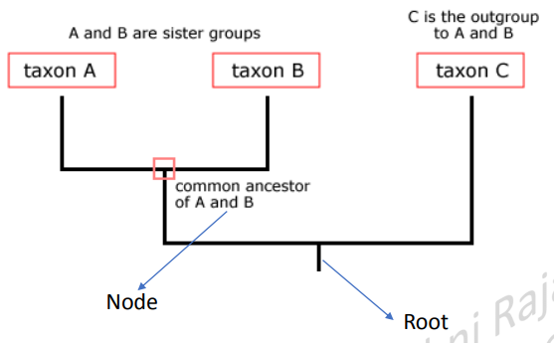
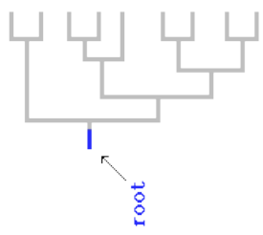
• Evolutionary tree -evolutionary relationships among taxa
• Phylogenies trace patterns of shared ancestry between lineages.
• The root of the tree represents the ancestral lineage
• Tips of the tree represent groups of descendants of that ancestor -descendent taxa (often species)
• Nodes - common ancestors of those descendants.
• As you move from the root to the tips, you are moving forward in time.
• Sister groups- species A & B are sister groups — they are each other's closest relatives.
• An outgroup is a species or group of species that is closely related to the ingroup the various species being studied

Slide 10
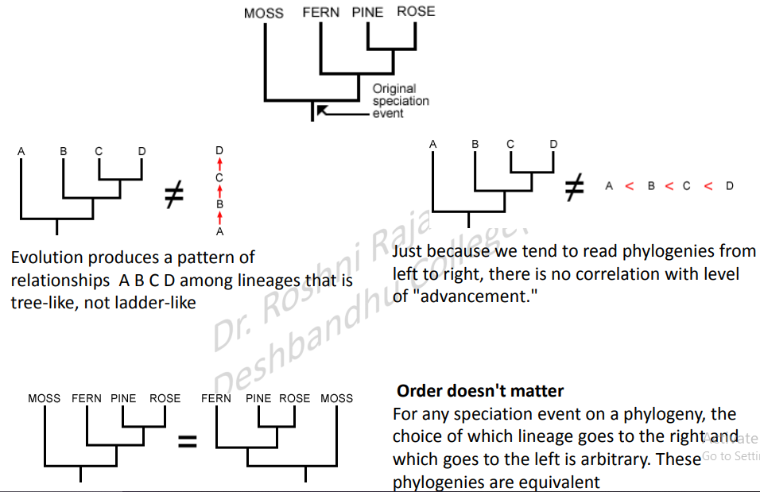

Slide 11
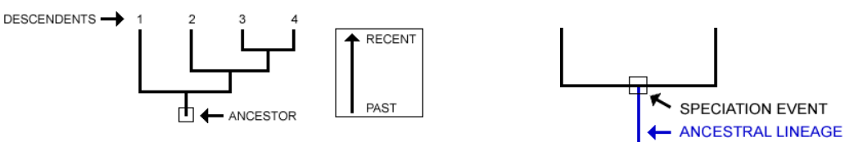
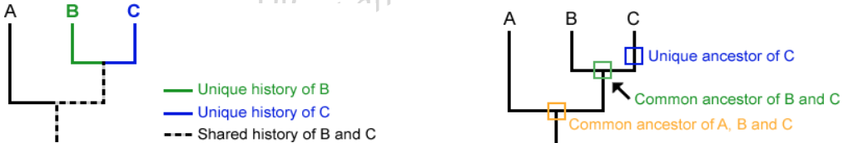

Slide 12
What is clade?
A clade is a group which includes a common ancestor and all the descendants (living and extinct) of that ancestor.
- Members of a clade will possess common characteristics as a result of their shared evolutionary lineage
- Clades can be organized into branching diagrams (cladograms) in order to show evolutionary relationships.

Slide 13

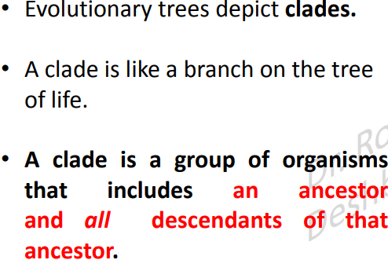
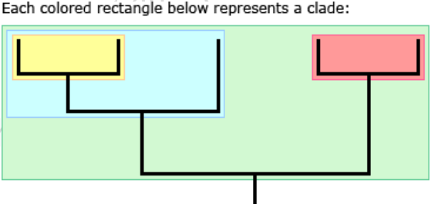

Slide 14
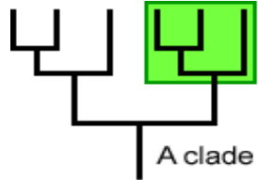
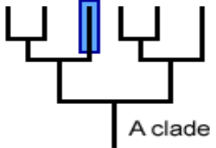
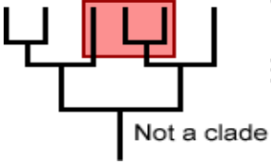
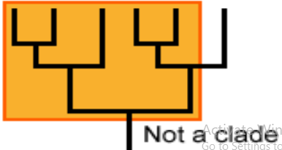

Slide 15
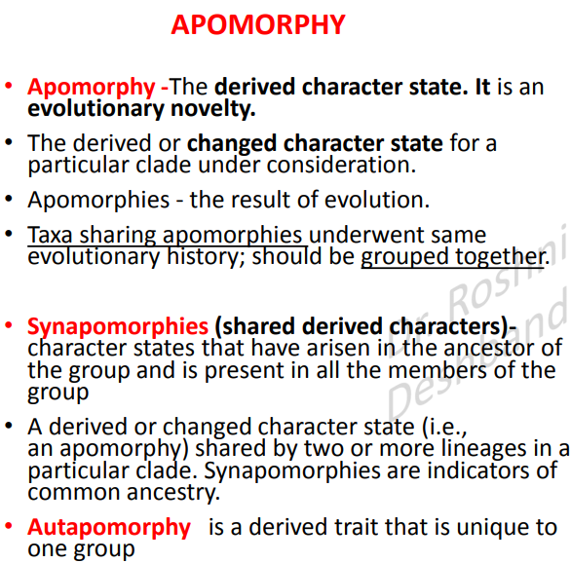
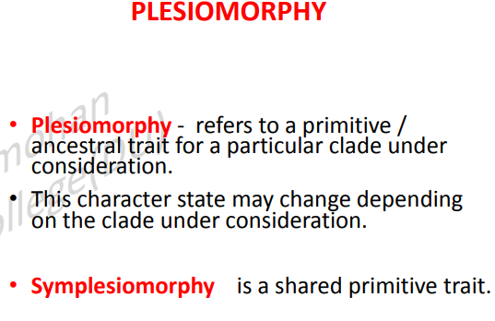

Slide 16
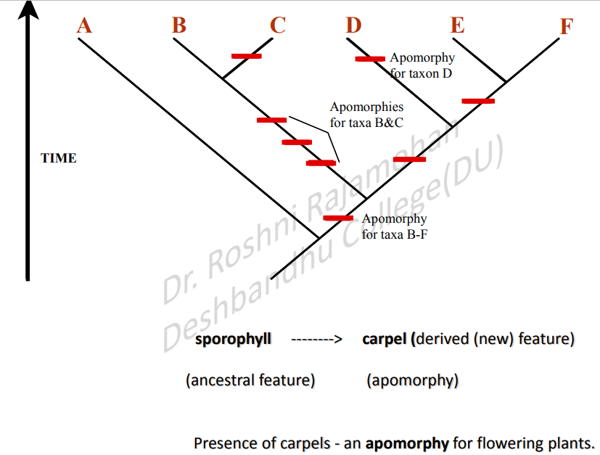

Slide 17
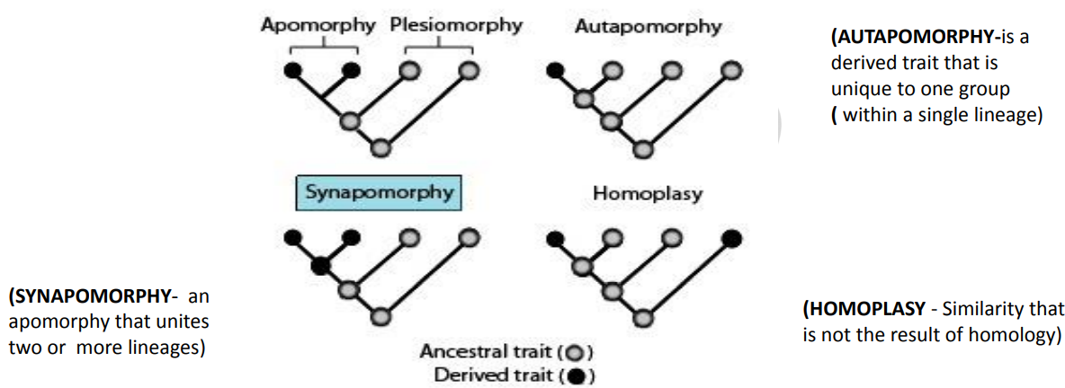

Slide 18
Phylogenetic approach
A taxon (pl. taxa) is any group of organisms that is given a formal taxonomic name. Loosely, a monophyletic taxon is one that includes a group of organisms descended from a single ancestor , whereas a polyphyletic taxon is composed of unrelated organisms descended from more than one ancestor.

Slide 19
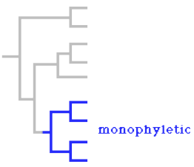
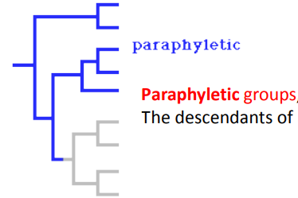
Phylogenetic approach
• A phylogenetic approach demands the taxa to be monophyletic.
• Monophyletic groups, including all the descendants of a common ancestor, are recognized and form entities in a classification system.
Monophyletic group (clade)- a group composed of an ancestor and all its descendants.
a common ancestor + all descendants of that common ancestor

Slide 20



Slide 21
Co-evolution of Angiosperms and Animals

Slide 22
Co-evolution refers to the evolution of at least two species, which occurs in a mutually dependent manner.
• Co-evolution was first described in the context of insects and flowering plants, and has since been applied to major evolutionary events, including sexual reproduction, infectious disease, and ecological communities.
•Co-evolution functions by reciprocal selective pressures on two or more species, analogous to an arms race in an attempt to outcompete each other.

Slide 23
Co-evolution Examples
Predator-Prey Co-evolution:
The predator-prey relationship is one of the most common examples of coevolution. In this respect, there is a selective pressure on the prey to avoid capture and thus, the predator must evolve to become more effective hunters. In this manner, predator-prey co-evolution is analogous to an evolutionary arms race and the development of specific adaptations, especially in prey species, to avoid or discourage predation.

Slide 24
Acacia ants and Acacias:
An example of co-evolution that is not characteristic of an arms race, but one which provides a mutual benefit to both a plant species and insect is that of the acacia ants and acacia plants. In this relationship, the plant and ants have coevolved to have a symbiotic relationship in which the ants provide the plant with protection against other potentially damaging insects, as well as other plants which may compete for nutrients and sunlight. In return, the plant provides the ants with shelter and essential nutrients for the ants and their growing larvae.

Slide 25
Flowering Plants and Pollinators:
Another example of beneficial co-evolution is the relationship between flowering plants and the respective insect and bird species that pollinate them. In this respect, flowering plants and pollinators have developed co-adaptations that allow flowers to attract pollinators, and insects and birds have developed specialized adaptations for extracting nectar and pollen from the plants.

