Slide 1
VIRTUAL HERBARIUM
Dr Habibur Rahman, Associate Professor,
J. N. College, Boko

Slide 2
VIRTUAL HERBARIUM :
In botany, a virtual herbarium is a herbarium in a digitized form. That is, it concerns a collection of digital images of preserved plants or plant parts. Virtual herbaria often are established to improve availability of specimens to a wider audience. However, there are digital herbaria that are not suitable for internet access because of the high resolution of scans and resulting large file sizes (several hundred megabytes per file). Additional information about each specimen, such as the location, the collector, and the botanical name are attached to every specimen. Frequently, further details such as related species and growth requirements are mentioned.

Slide 3
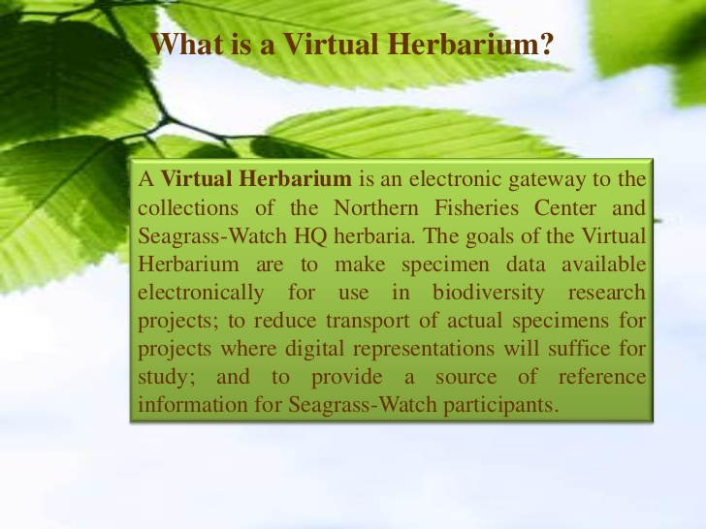

Slide 4
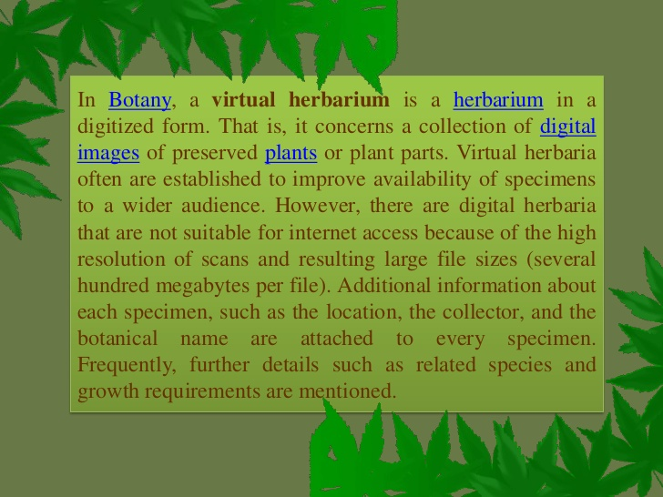

Slide 5
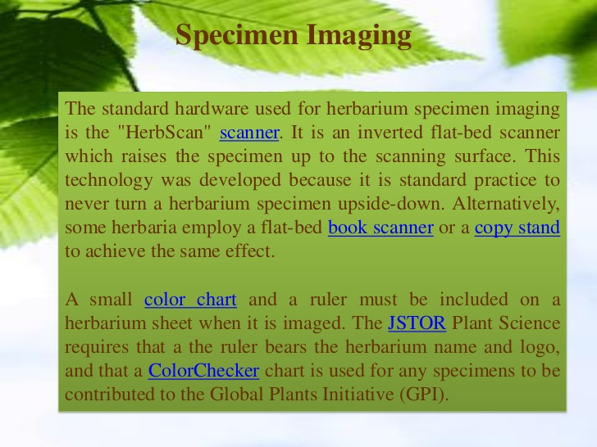

Slide 6
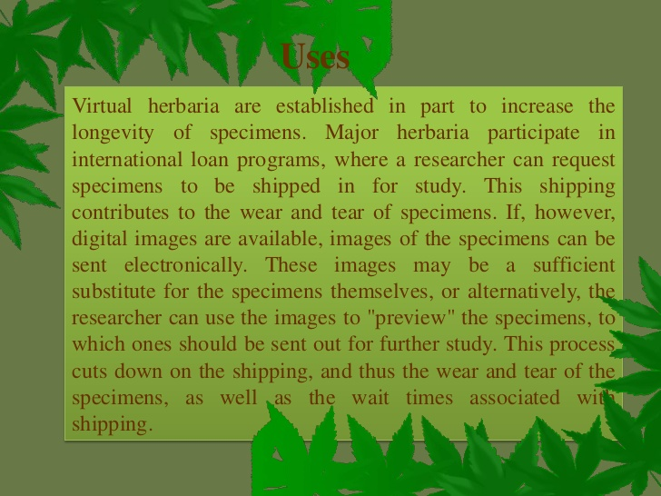

Slide 7
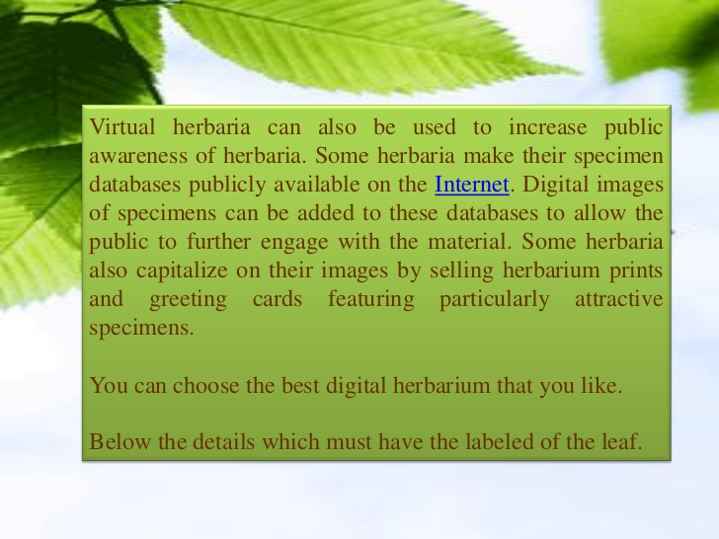

Slide 8
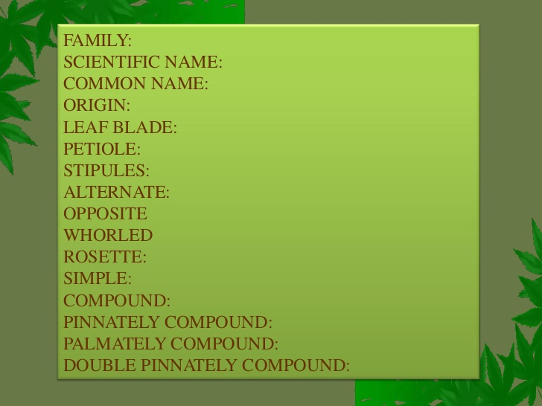

Slide 9
MERITS:
In active herbarium, there is a replacement of spoiled herbarium sheets at regular intervals with freshly procured ones is usual phenomenon, whereas E. herbarium is a permanent record with clarity and no replacement is required.
2) In traditional herbarium, there are several steps involved in the herbarium preparation (like plant collection, pressing, drying, mounting etc.) whereas E. herbarium is a rapid one without involvement of these steps.
3) Electronic herbarium is non-destructive method i.e. real plant material is not killed (eco-friendly), which is present in traditional one.
4) Fading of colours of plant specimens in traditional herbarium is a common problem and it makes us difficult in identification of specimen based on herbarium sheets. In E. herbarium, the original colours are retained for any number of years.
5) In traditional herbarium, the habit and habitat of specimens cannot be seen and we have to rely on field notes, whereas in electronic herbarium, which can be visualized.

Slide 10
DEMERITS:
The demerits or drawbacks of E. herbarium are 1) real plant specimen is not
stored and 2) there is no chance of observing aroma of plants (at present), which is an identification character of a particular specimen or family. However, very recently Korean technocrats have solved this problem and in near future, we can overcome it. Some problems related to computer and electronic devices can exist, however, it can be solved in consultation with computer engineers easily.

