Slide 1
HERBARIUM
PREPARATION OF HERBARIUM SHEETS, PRESERVATION, STORAGE AND STAINING OF MATERIALS
Dr Habibur Rahman, Associate Professor,
J. N. College, Boko

Slide 2
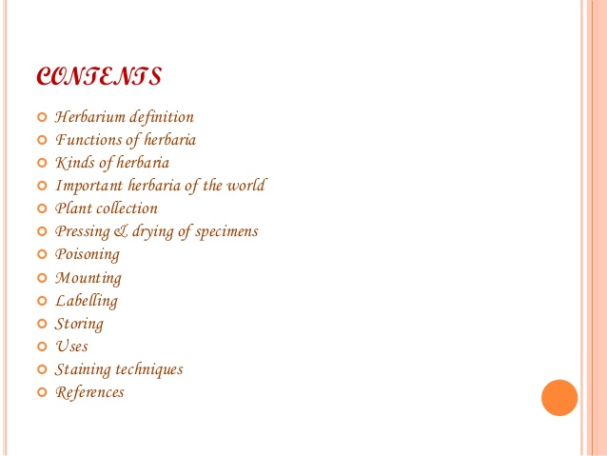

Slide 3
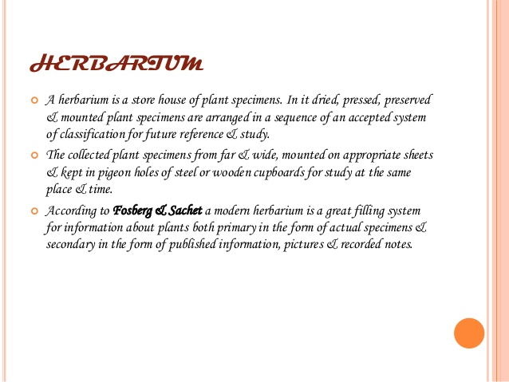

Slide 4
Herbarium
A herbarium is a storehouse of plant specimens which are collected, dried and mounted on handmade paper sheets. They will be arranged in plant families with the help of recognized system of classification and kept in pigeon holes of steel or wooden cup boards and maintained carefully for current and future studies.
The art of herbarium was initiated by an Italian
taxonomist Luca Ghini (1490-1556).
The word herbarium was first used by Carolus Linnaeus
The definite size of herbarium sheet is 29 X 41cms. ± 1cm

Slide 5
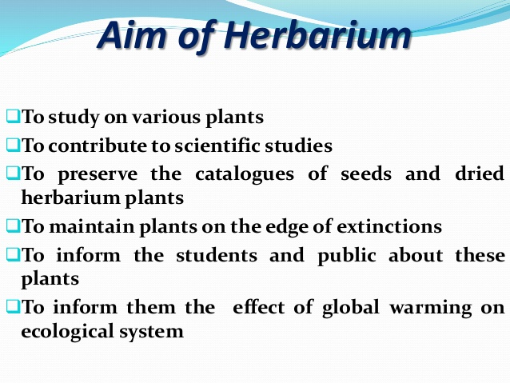

Slide 6
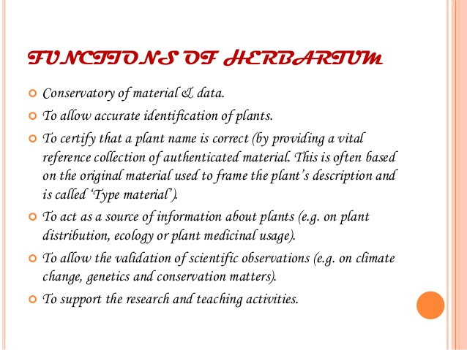

Slide 7
Functions of Herbarium:
A modern Herbarium serves valuable functions or utility. Important of them are as follows:
(i) It is an invaluable conservatory of plant material and data.
(ii) It is storehouses of collection including the valuable type specimens. The herbaria greatly aid in all kinds of taxonomic researches.
(iii) Serves as a fundamental resource for identification of all plants of the world.
(iv) It serves as a source for collections biodiversity. Most estimates on global biodiversity today are based on herbarium collection only.
(v) It aids in biodiversity monitoring by carrying out security of herbarium collection to obtain quantitative baseline data on the distribution and abundance of keystone species is essential for all monitoring programmes.
(vi) It serves as a repository of voucher specimens on which varieties Botanical researches are carried out.
(vii) Aids in assessment of conservation status of a taxon.
(viii) Vast collection of a particular species in a herbarium aids in assessing the diversity or variations exhibited by a species in its distributional ranges helping in population biology studies.
(ix) It serves as a source for search of new genetic material for improvement of cultivated stock.

Slide 8
(xi) Herbarium serves as an aid in teaching botany. Dried specimen is available all the time as compared to the fresh plant which may or may not be available. It helps in identifying the newly collected specimen.
(xii) Specimen may be used as a source of material for Anatomy, Palynology and Cytotaxonomy, Ecology, Chemistry, Molecular biology, Pharmacognosy and Environment impact assessment.
(xiii) Seeds of the herbarium specimens can be used to resurrect species extinct in the wild using modern technology.
(xiv) It aids in assessment and cataloguing of all species of economic potential, as commercial species, medicinal herbs, food plants etc.
(xv) It helps in development of computer data base on plants and maintains active links to international network of systematic resources and electronic base.

Slide 9
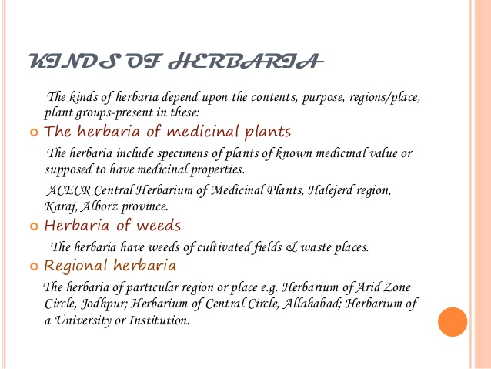

Slide 10
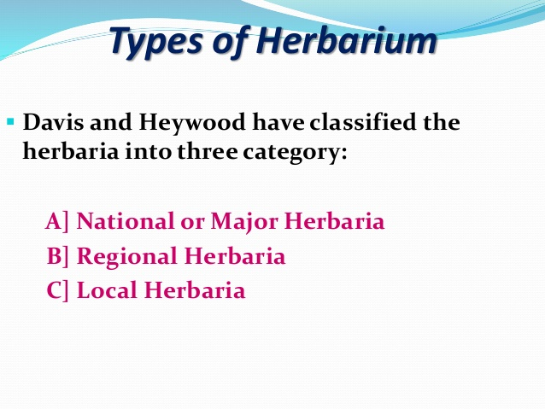

Slide 11
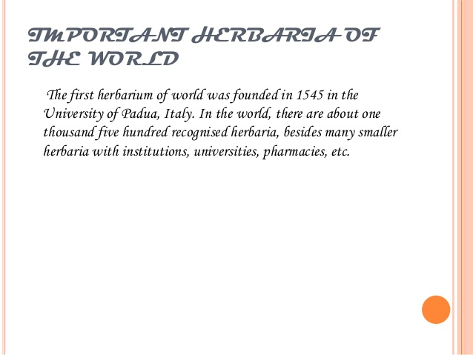

Slide 12
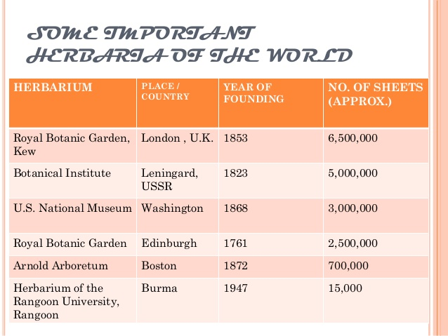

Slide 13
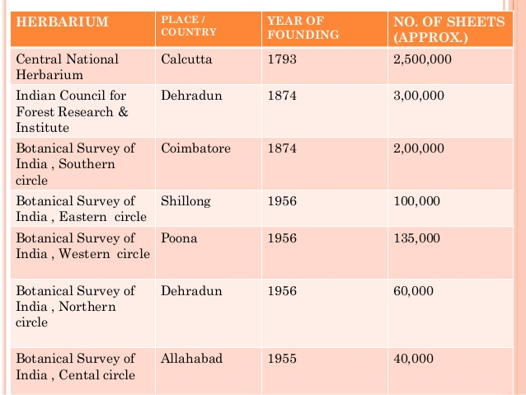

Slide 14
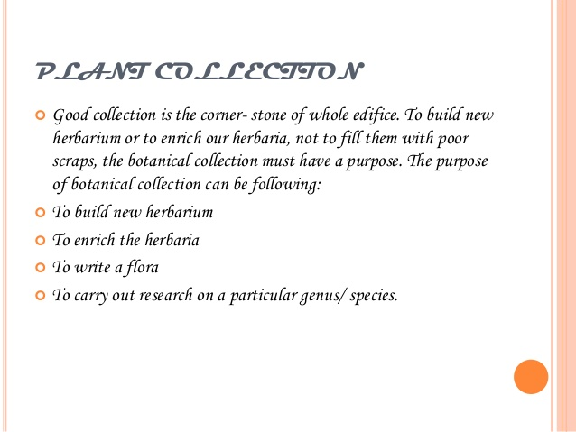

Slide 15
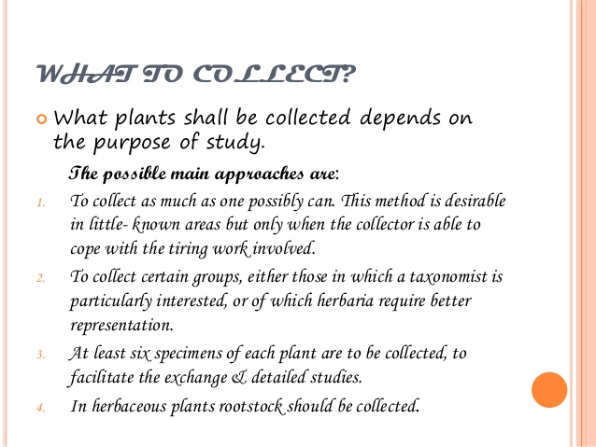

Slide 16
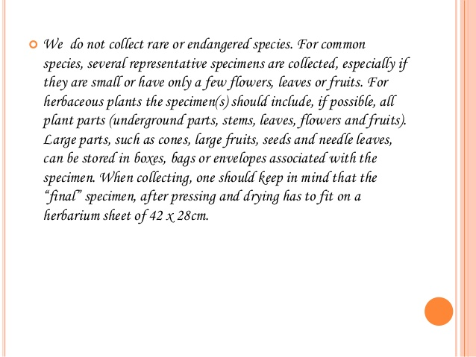

Slide 17
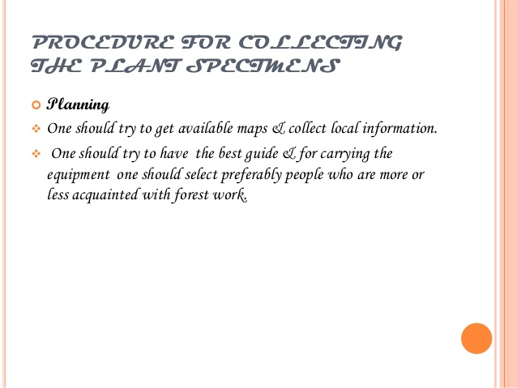

Slide 18
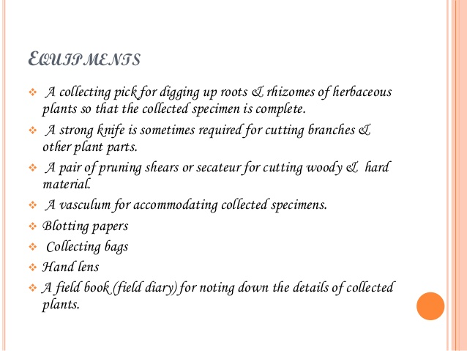

Slide 19
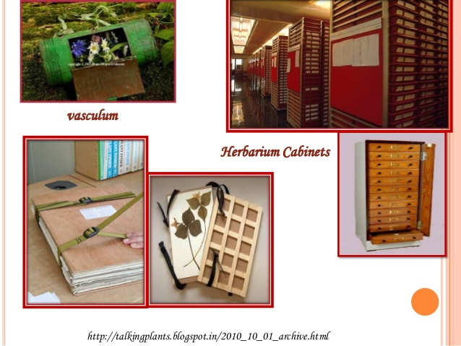

Slide 20
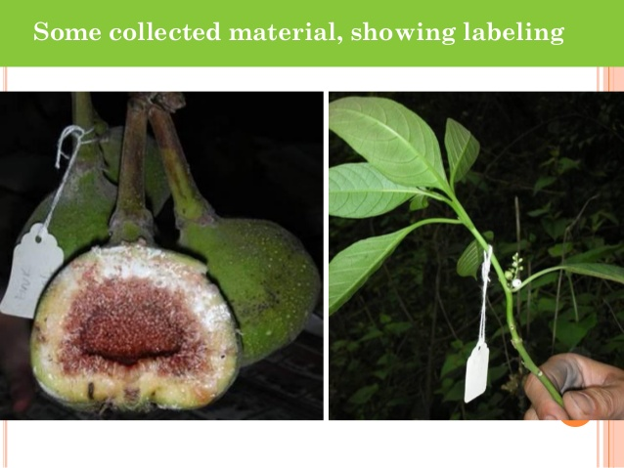

Slide 21
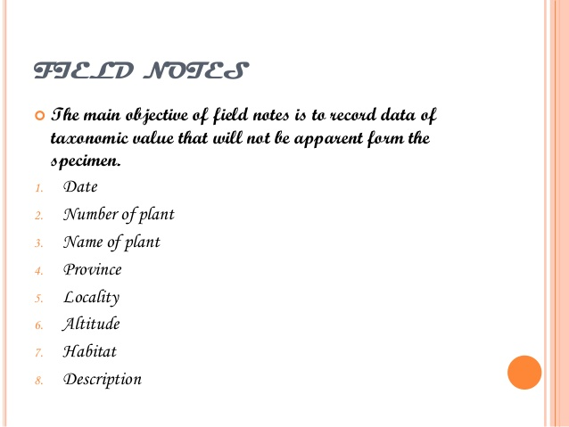

Slide 22
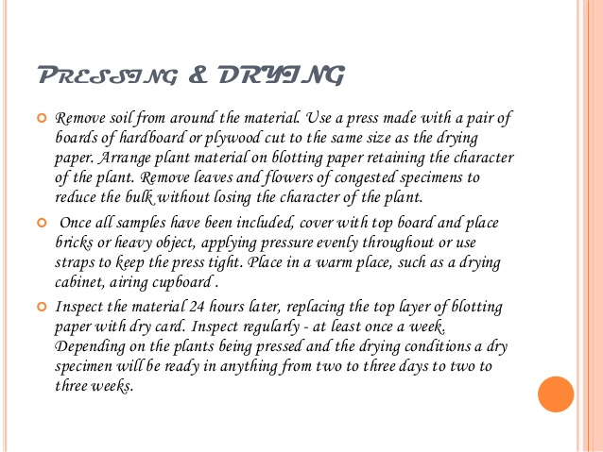

Slide 23
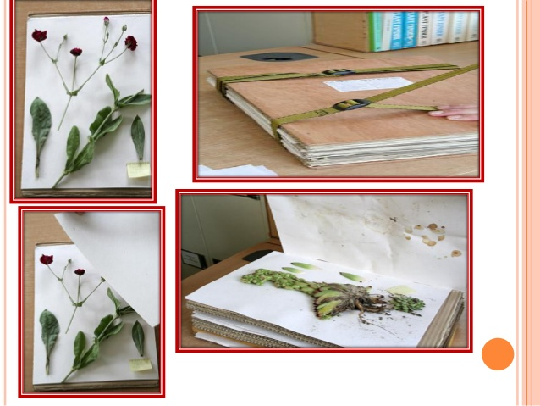

Slide 24
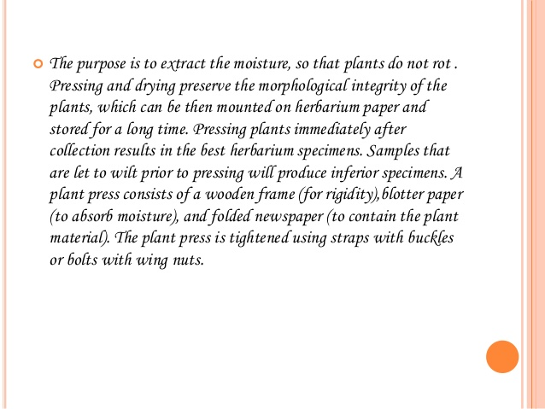

Slide 25
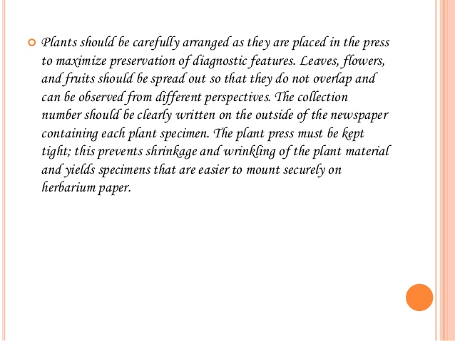

Slide 26
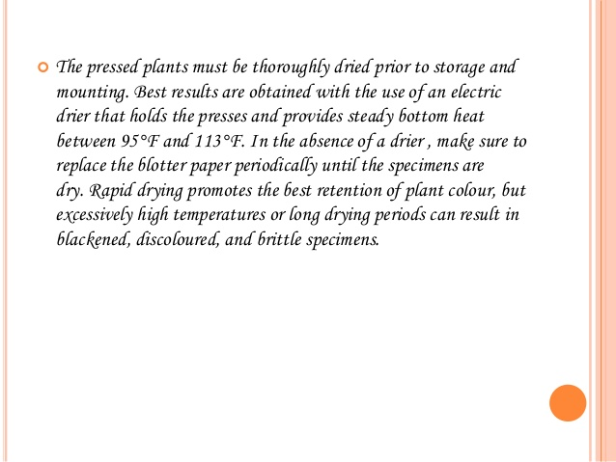

Slide 27
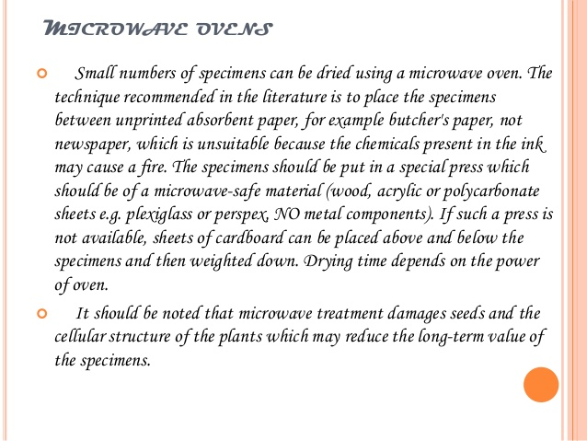

Slide 28
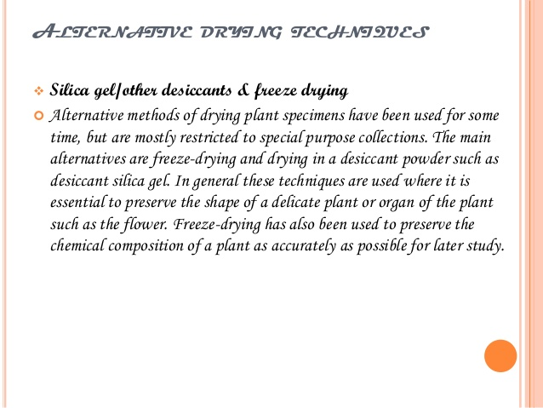

Slide 29
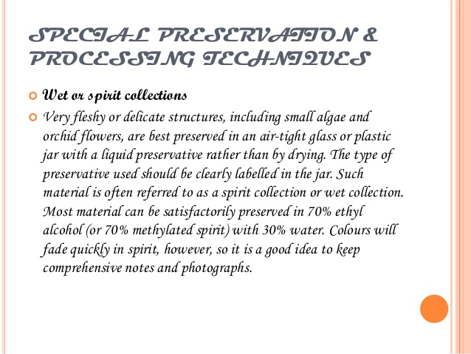

Slide 30
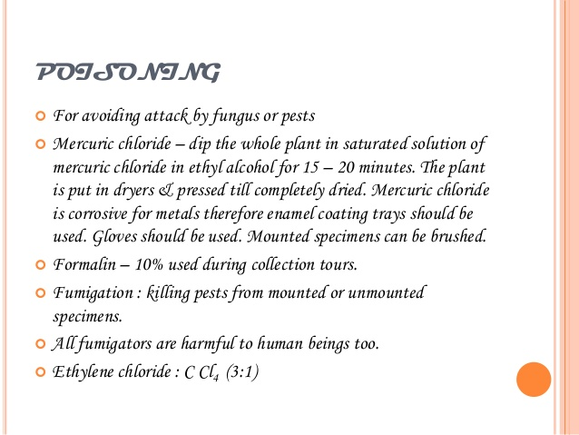

Slide 31
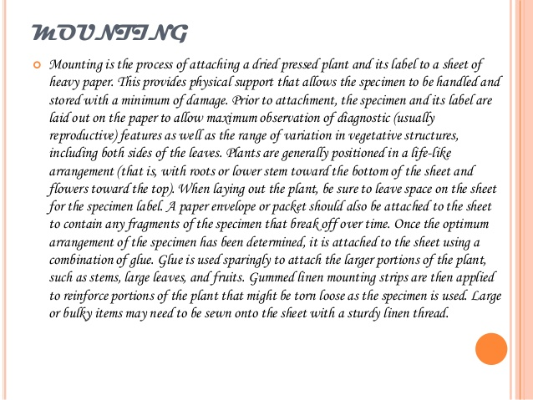

Slide 32
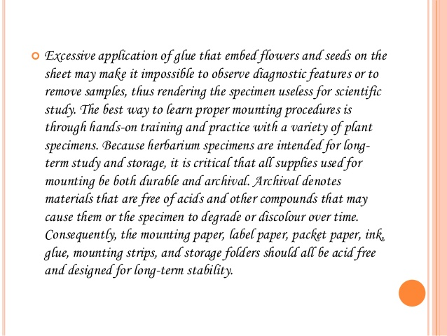

Slide 33
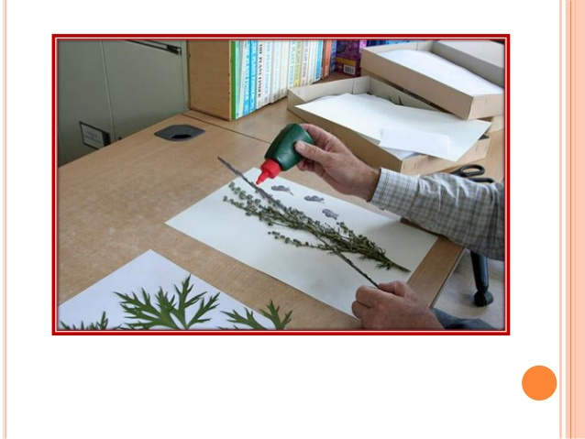

Slide 34
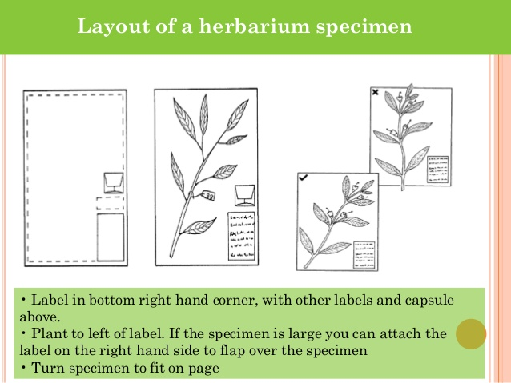

Slide 35
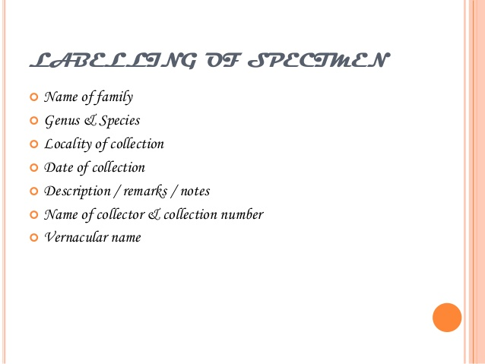

Slide 36
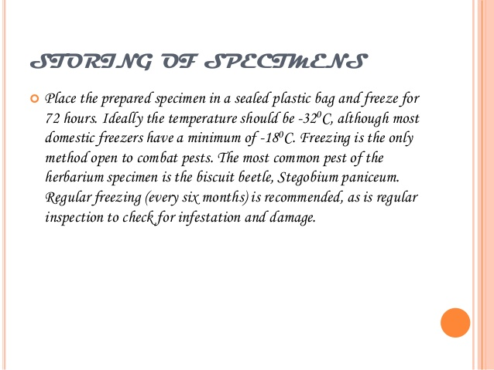

Slide 37
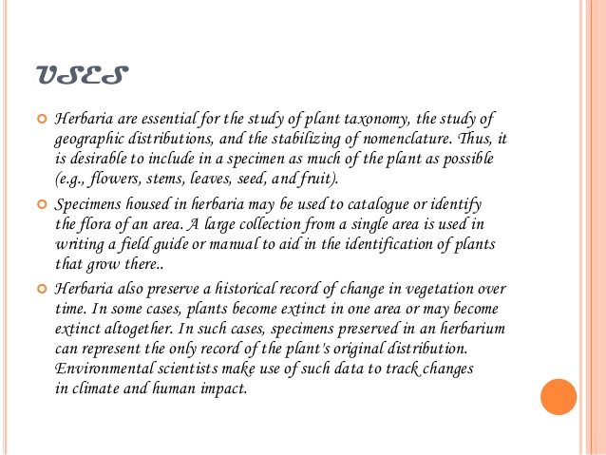

Slide 38


