Slide 1
Remote Sensing
Platform and Sensor
Presented By
Dr. Banashree Saikia
Assistant Professor
Department of Geography
JN College,
Boko

Slide 2
Platforms of Remote Sensing
Remote Sensing images are obtained at distances from various platforms.
The vehicles or carriers for remote sensors are called the platform.
On the basis of these platforms, the techniques and types of remote sensing also vary. There are three main categories of platforms namely ground borne, air borne and space born.
Ground borne platform include ladder trucks or cherry pickers for ground investigation.
Airborne plate form include aircraft, helicopter and ballon based plateform.

Slide 3
Sensor carried by balloons which are designed and used for specific projects. In these balloon based platform we have low latitude tethered balloons connected to the earth station by means of wires.
The sphere types balloons used to obtain high resolution photograph of planets from altitude of about 25km.
Remote sensing plateform
Air Borne Plateform
Aircraft
Helicopter
Ballons
Space Borne plateform
Rocket
Space shuttle
Satellite( i.Geostationary or earth synchronous and ii. Sun synchronous)

Slide 4
Air borne plateform: Presently available airborne platforms helicopters, drones and air crafts for low latitude photography. The aerial photographs are taken for mico-level planning and topographic mapping in great details.
Sensors carried by aircraft, these sensors generally obtain images at height of 500 mt. to 20 km. Aircrafts are useful for good regional cover ages with high resolution.
Space borne plateform: Space borne platforms include rocket, space shuttle and satellite.

Slide 5
Sensors carried by spacecraft, which generally operate an altitudes of around 250- 300 km. Many remote sensing satellites operate approximately thousand k.m above the earth.
Very high altitude satellites operate 36000 km. above the earth. These are geostationary satellites which remain over the same part of the earth at all times.
The advantage of satellite as a space borne platform is that they can be placed in a well defined orbit.
They are not affected by the atmosphere.

Slide 6
Depending on the types of orbit in which the satellite move, broadly they can be divided into two categories:
(a) Geostationary or Earth Synchronous Satellite:
These platforms are placed at very high altitude from the earth’s surface.
The orbit in which these satellite moved termed as Geostationary, in the sense that earth’s rotation speed is equivalent to the revolution speed of the satellite.
Orbital height of these satellite from the earth surface is 36000km.
The orbit is parallel to the equator.
The spatial resolution of the image generated by these satellite are very poor.
These images are mainly used for communication and weather forecasting purpose .
GOES (USA),INSAT (India), GMS(Japan) group of satellite are fall in this category.

Slide 7
Sun Synchronous or Polar Orbiting Satellite:
Orbital height of the polar orbiting or sun synchronous satellites from the earth’s north pole or south pole is in between 800-1000km.
The orbit of such satellite is placed in the sun’s plane and passes close to the pole and is able to cover nearly the whole earth surface in a repeat cycle.
The satellite passes a particular place at same local time at regular interval.
The spatial resolution of the image generated by these satellite are very high up to sub- meter.
The data generated by these satellite are highly useful for natural resource surveying, monitoring and management. IRS, LANDSAT are these group of satellite.

Slide 8
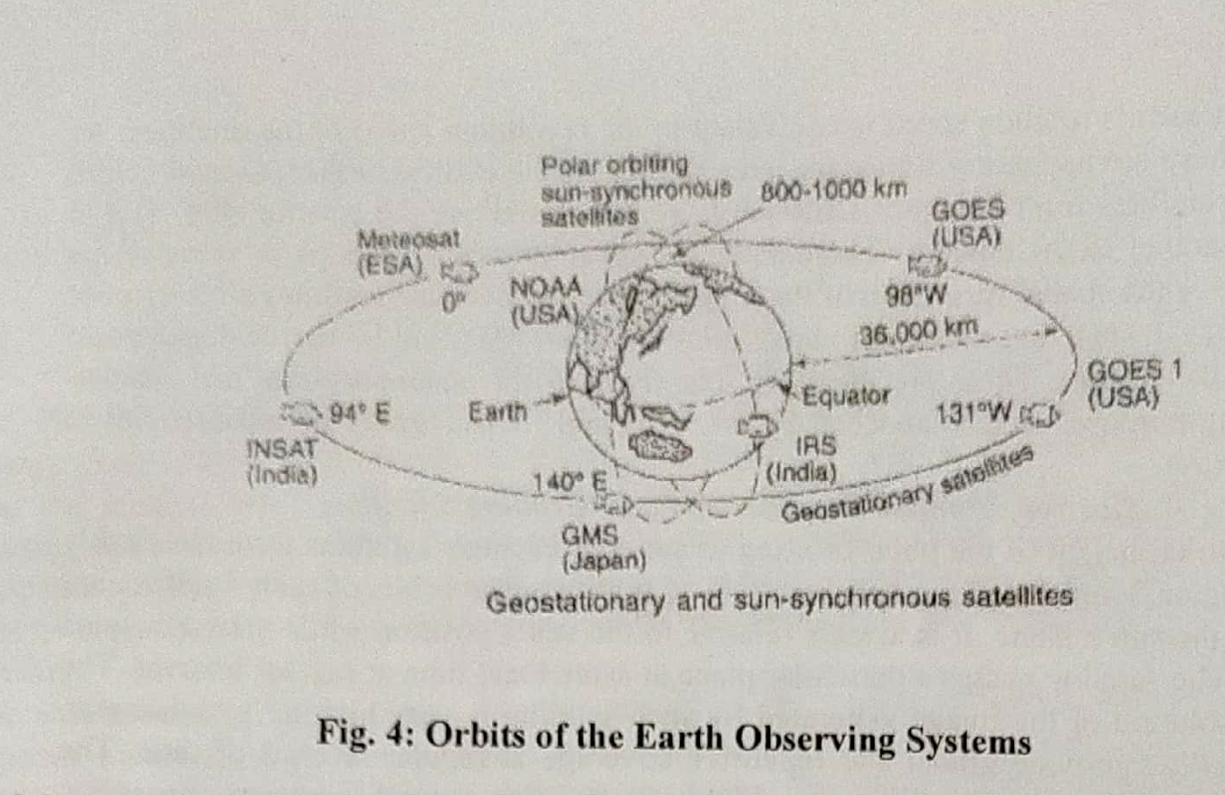

Slide 9
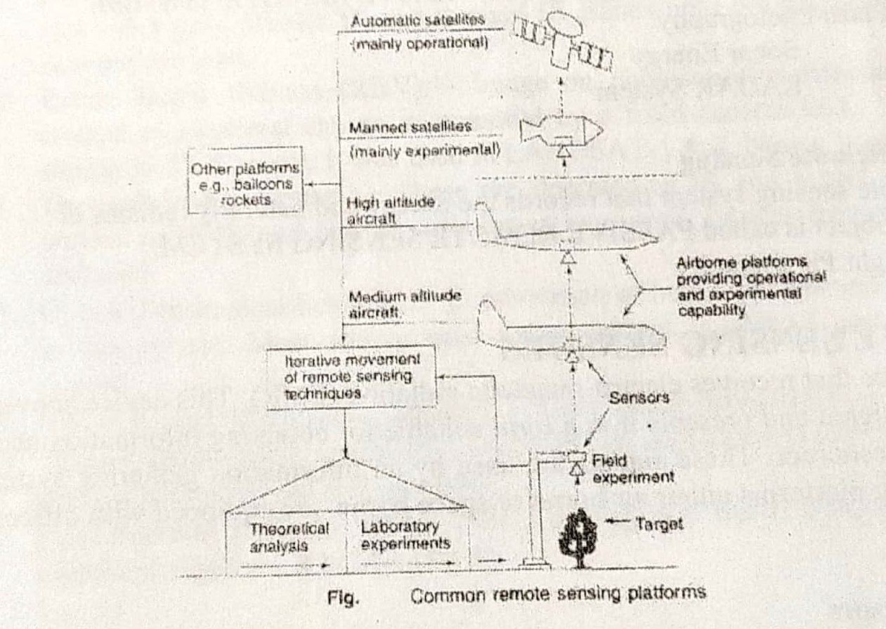

Slide 10
Sensor
It is a device which can perceive the information through the reflected / emitted light from various objects.
Types of Sensors:
Remote Sensing sensors are of two types based on the energy used by sensor for the data collection (a) Active sensor (b) Passive sensor
Active sensor is the one which sends a beam of energy on to the object and detects the reflected energy.Ex. RADAR.
Passive sensor is the the one which uses the sun as the source of energy and detects the reflected energy . Example of passive Sensor are normal photo graphic camera, various scanners and radiometers.

Slide 11
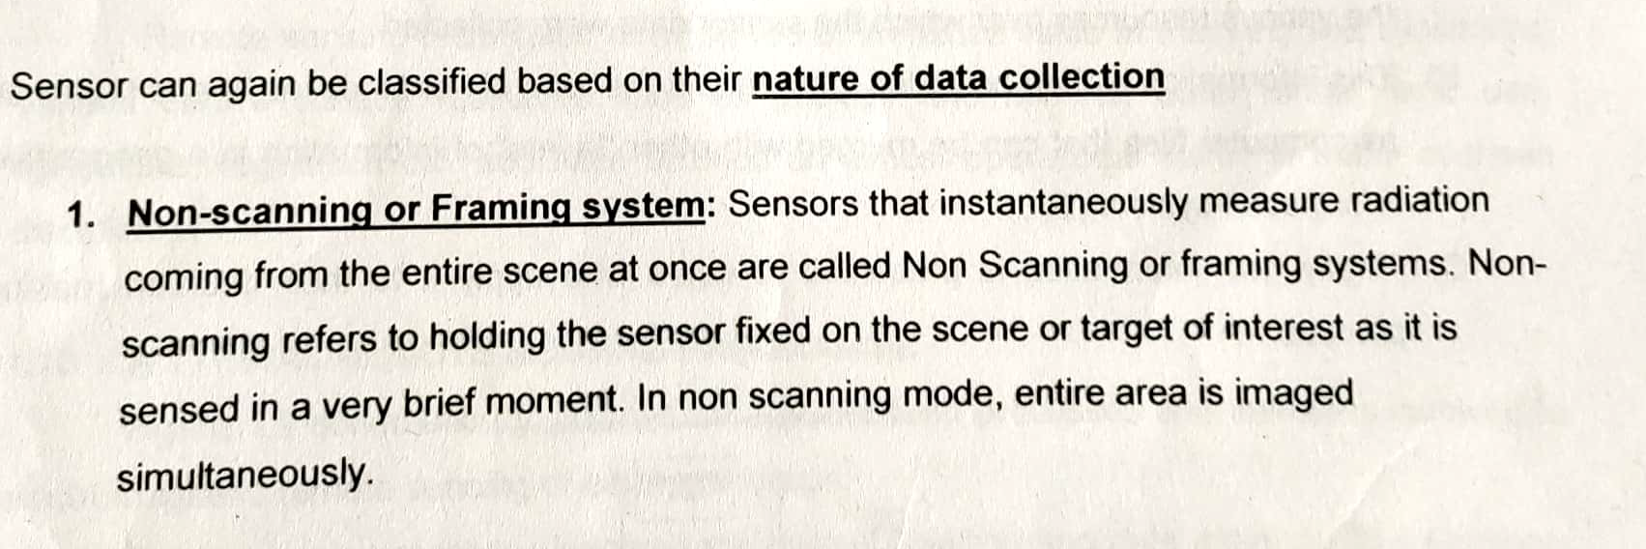

Slide 12
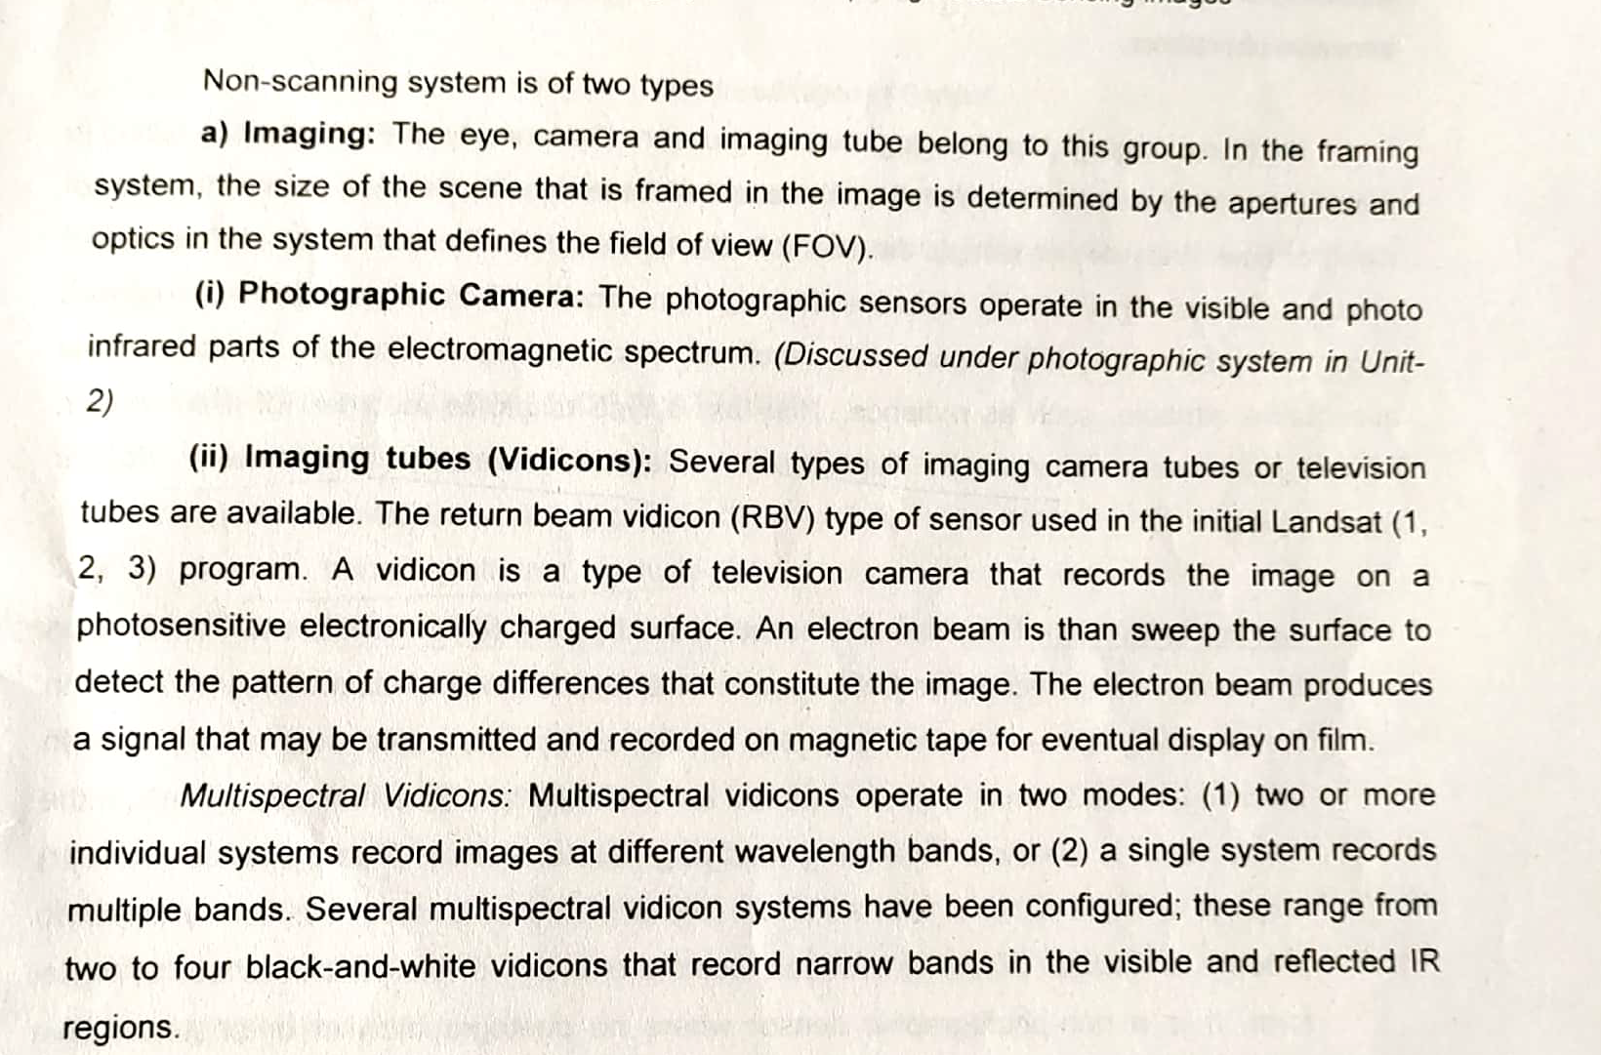

Slide 13
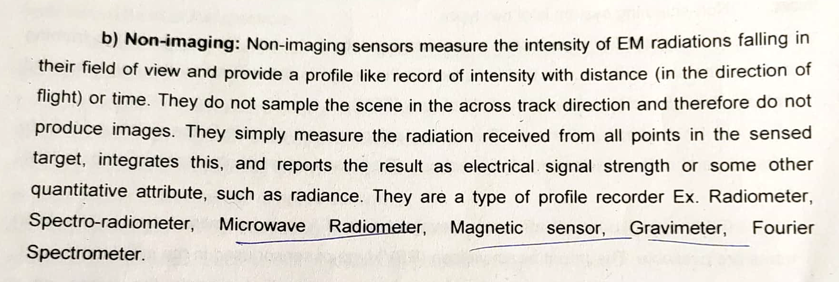

Slide 14
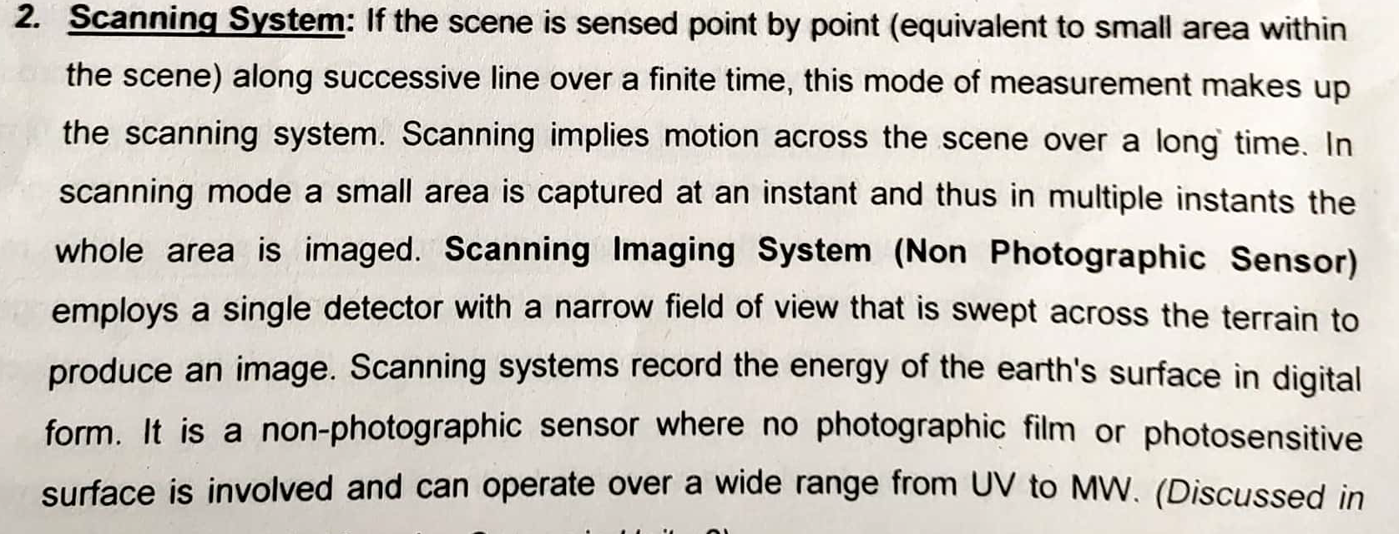

Slide 15
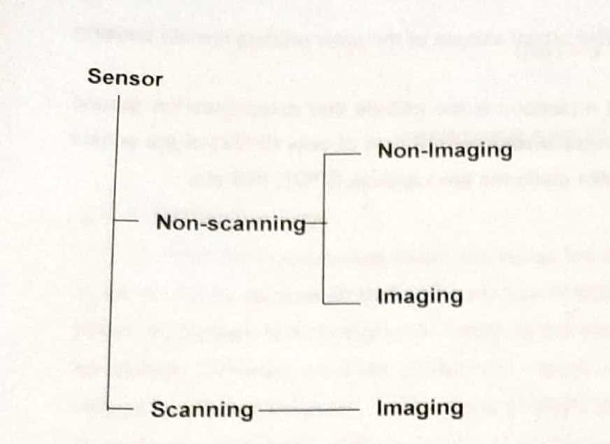
Fig: Classification of sensors

Slide 16
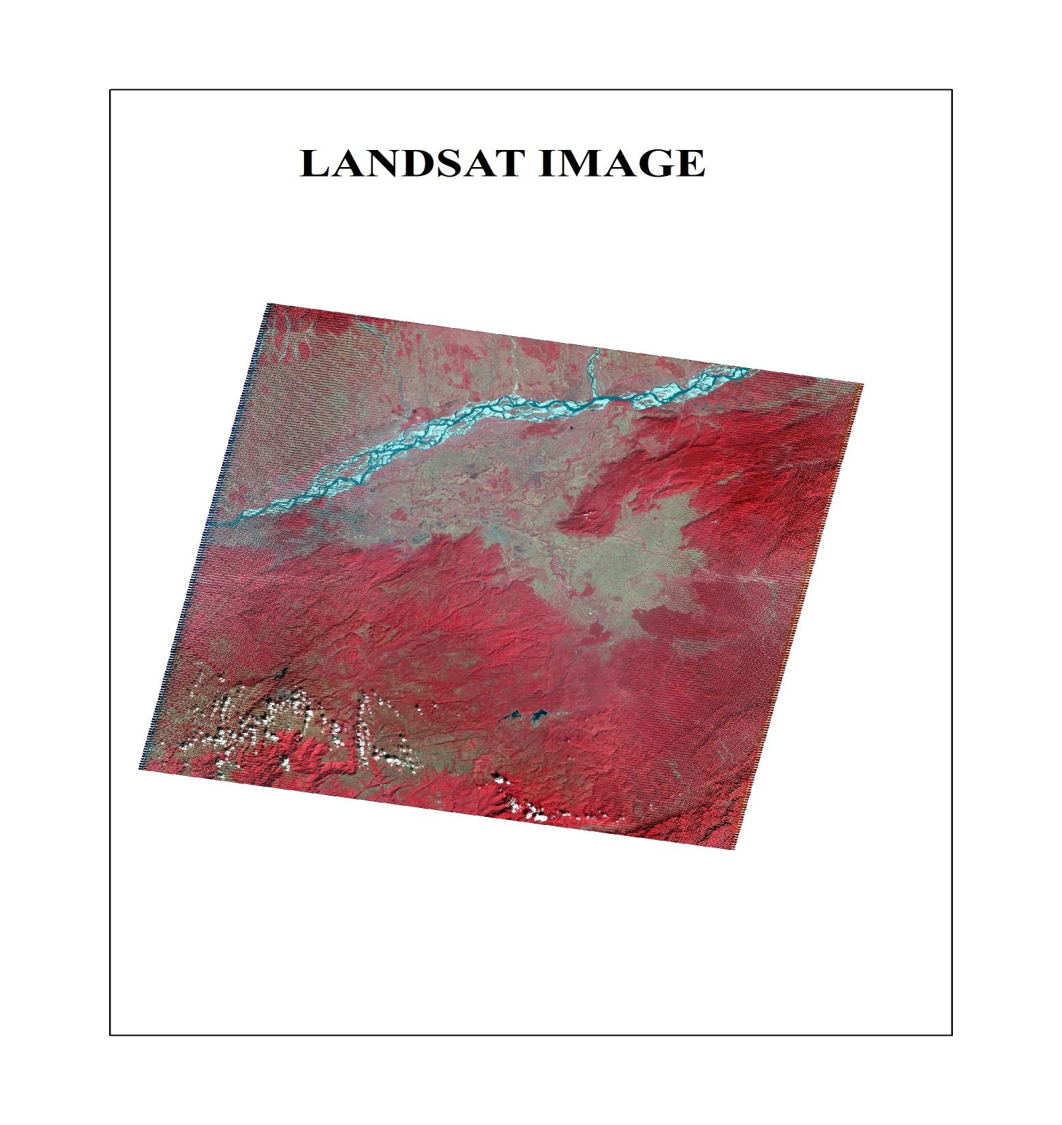
Remote
Sensing image which is obtained by sensor

